Slide 1



DEPARTMENT OF ELECTRONICS AND INSTRUMENTATION ENGINEERING DESIGN AND IMPLEMENTATION OF AN AUTOMATED ROBOTIC ARM USING IOT
Presented by
V. ADHIBAN SIDDARTH (510418107001)
S. SATHISH (510418107002)
M. SURYA (510418107003)
Supervisor: Mr. V. VELMURUGAN, AP/EIE

Slide 2
DOMAIN IOT & ROBOTICS
TITLE
DESIGN AND IMPLEMENTATION OF AN AUTOMATED ROBOTIC ARM USING IOT

Slide 3
ABSTRACT
A robotic arm, sometimes referred to as an industrial robot, it is a device that operates in a similar way to a human arm, with a number of joints that either move along an axis or can rotate in certain directions. In fact, some robotic arms are anthropomorphic and imitate the exact movements of human arms. They are, in most cases programmable and used to perform specific tasks, most commonly for manufacturing, fabrication, and industrial applications. Robotic arms were originally designed to assist in mass production factories, most famously in the manufacturing of cars. They were also implemented to mitigate the risk of injury for workers, and to undertake monotonous tasks, so as to free workers to concentrate on the more complex elements of production.

Slide 4
INTRODUCTION
A robotic arm is a type of mechanical arm, usually programmable, with similar functions to a human arm; the arm may be the sum total of the mechanism or may be part of a more complex robot.
The links of such a manipulator are connected by joints allowing either rotational motion (such as in an articulated robot) or translational (linear) displacement.
The links of the manipulator can be considered to form a kinematic chain.
The terminus of the kinematic chain of the manipulator is called the end effector and it is analogous to the human hand.
However, the term "robotic hand" as a synonym of the robotic arm is often proscribed.

Slide 5
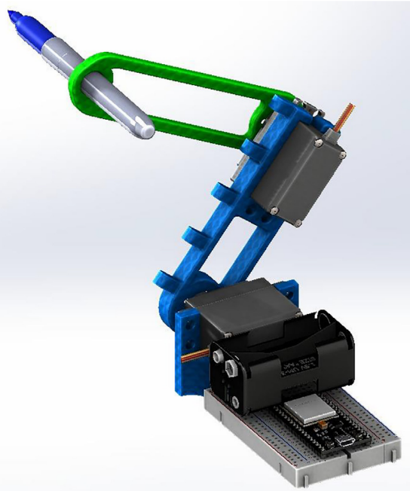
EXISTING SYSTEM
ROBOT ARM FOR ONLINE TEACHING OF ROBOTICS COURSES
The design and construction of an affordable, open-source robot arm for online teaching of robotics courses. The main goal of the proposed robotic prototype is to deal with the current situation of pandemic contingency, where students and instructors cannot attend laboratory facilities in person. The robotic system has four main components: an electromechanical robot arm structure, a control system, a Wi-Fi communications module, and a human-machine interface.

Slide 6
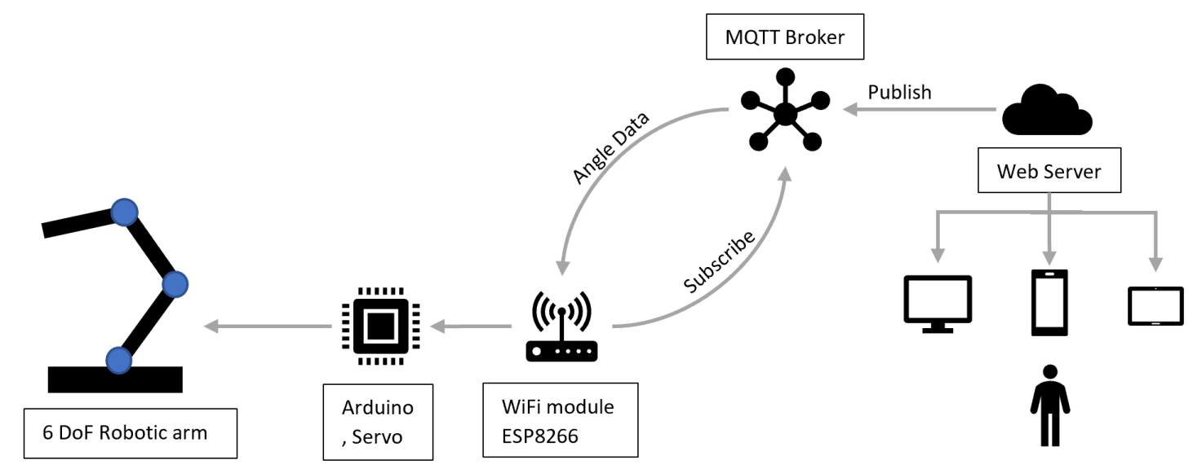
ROBOTIC ARM CONTROL BASED ON IOT WITH ARDUINO
A six degree of freedom robotic arm is the most widely used mechanical device in the field of robotics. It can work in the various complex environment and has the accuracy and precision that the human arm cannot achieve.
Generally, the motion of a robotic arm needs to be controlled by a wired teach pendant or computer control. However, in some complex environments, it is impossible to achieve short- distance control wireless control. Real-time remote data transmission is also the key to achieve precise control of the robotic arm, and if the control terminal can be realized anytime and anywhere, the robotic arm can be controlled remotely.

Slide 7
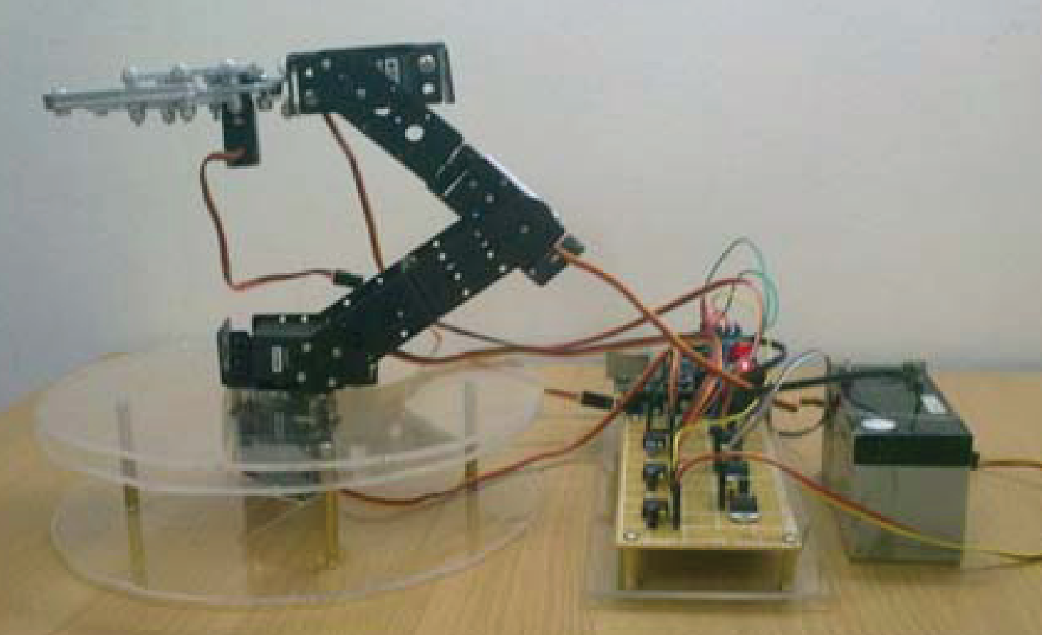
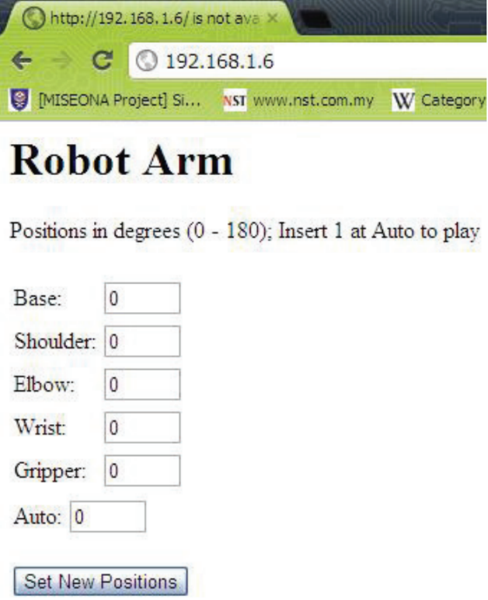
CONTROL ROBOTIC ARM USING IP ADDRESS
When we talk about robots, people tend to think that robots are only suitable to use in the industry or just for the scientist to test about new technologies. However, the main function of robots is to help humans in doing work either in the industries or just helping out doing normal household chores.
To bridge the gap of the normal perception of “robots are for the industries only”, internet will be use. This paper presents the development of an internet controlled robotic arm. The movement of the robot arm can be controlled by a computer via the internet.

Slide 8
PROPOSED WORK
IOT
The Internet of Things (IoT) describes the network of physical objects— “things”—that are embedded with sensors, software, and other technologies for the purpose of connecting and exchanging data with other devices and systems over the internet.
LAN
A local area network (LAN) is a collection of devices connected together in one physical location, such as a building, office, or home. A LAN can be small or large, ranging from a home network with one user to an enterprise network with thousands of users and devices in an office or school. Regardless of size, a LAN's single defining characteristic is that it connects devices that are in a single, limited area. A LAN, or local area network, is a group of connected computing devices within a localized area that usually share a centralized Internet connection.

Slide 9
The robotic arm is going to be controlled by using WiFi, here we are using FOG computing. There is Cloud, FOG, Edge computing available in Internet of things.
Cloud computing is that the data is sent through internet to the cloud server. Mainly cloud is used to process and store the large amount of data. Cloud has another advantage that is the data can be obtained from any where from the world where there is internet available.
FOG computer is that there is no need of WAN, only LAN is enough for this. In FOG computing the data is stored in the local storage. It has some advantages, when internet is slow the data transfer from server to the client will be slow. It makes some delay; it causes some disadvantages.
But in FOG computing the data storage is in local, data transfer is faster than cloud, then the process is done faster. FOG computing is used in LAN like WiFi, Ethernet etc. The local server is connected to the client using WiFi, then the data is transferring between client and server. In our project data transfer speed is important and low storage only required.

Slide 10
So, FOG computing is best for this project. Fog computing is a computing architecture in which a series of nodes receives data from IoT devices in real time. These nodes perform real-time processing of the data that they receive, with millisecond response time.
Edge computing, a strategy for computing on location where data is collected or used, allows IoT data to be gathered and processed at the edge, rather than sending the data back to a datacentre or cloud. Together, IoT and edge computing are a powerful way to rapidly analyze data in real-time.
But in Edge computing the data storage must be placed nearer to the place where the data is getting or giving to them. In our project robotic arm is controlled and automation data is stored in wirelessly so Edge computing is not used in this project.
Edge computing gives more speed data transfer but less flexibility. FOG computing has enough speed and flexibility for the robotic arm and it is one of the best methods also.

Slide 11
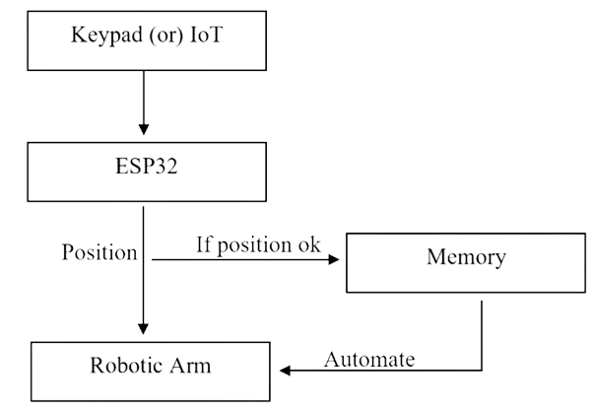
WORKFLOW

Slide 12
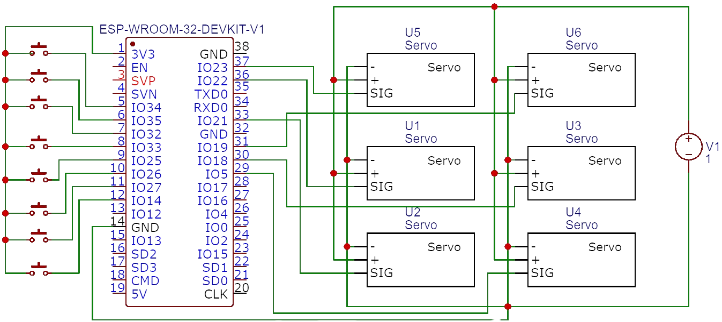
CIRCUIT DIAGRAM

Slide 13
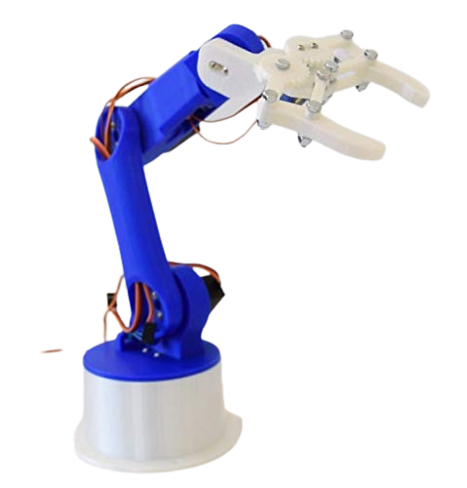

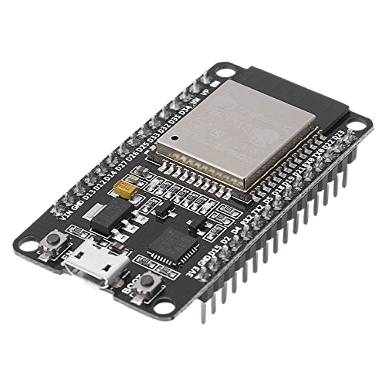

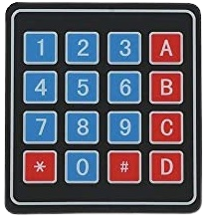

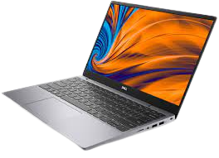
DIAGRAM
5V Power
Robotic Arm
ESP32
Microcontroller
5V Power
Keypad
Laptop
Mobile

Slide 14
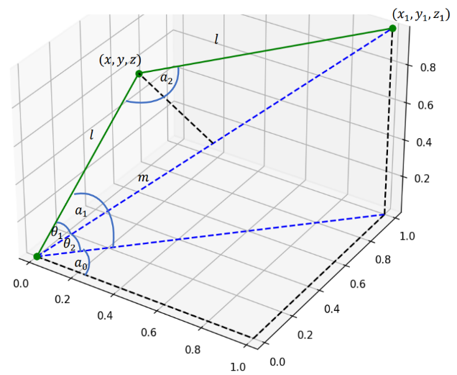
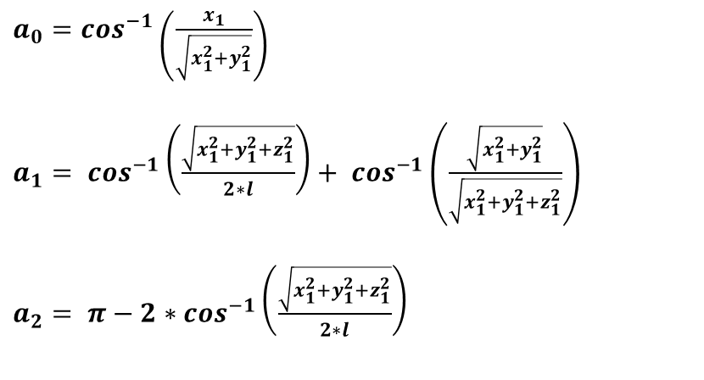
KINEMATICS
Kinematics is the study of the motion of mechanical points, bodies and systems without consideration of their associated physical properties and the forces acting on them. The study is often referred to as the geometry of motion, and it models these motions mathematically using algebra.
Inverse kinematics takes as input the Cartesian end effector position and orientation, and calculates joint angles.
Forward kinematics (for a robot arm) takes as input joint angles, and calculates the Cartesian position and orientation of the end effector.
$a_{0}=\cos^{−1}\left(\frac{x_{1}}{\sqrt{x_{1}^{2}+y_{1}^{2}}}\right)$
$a_{1}= \cos^{−1}\left(\frac{\sqrt{x_{1}^{2}+y_{1}^{2}+z_{1}^{2}}}{2∗l}\right)+ \cos^{−1}\left(\frac{\sqrt{x_{1}^{2}+y_{1}^{2}}}{\sqrt{x_{1}^{2}+y_{1}^{2}+z_{1}^{2}}}\right)$
$a_{2}= π−2∗\cos^{−1}\left(\frac{\sqrt{x_{1}^{2}+y_{1}^{2}+z_{1}^{2}}}{2∗l}\right)$

Slide 15
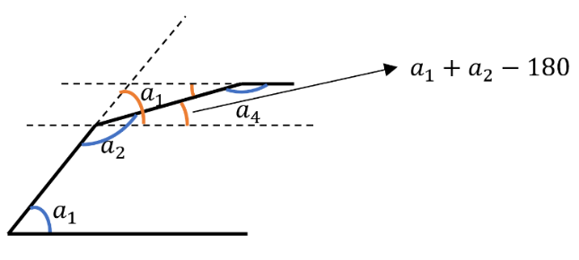
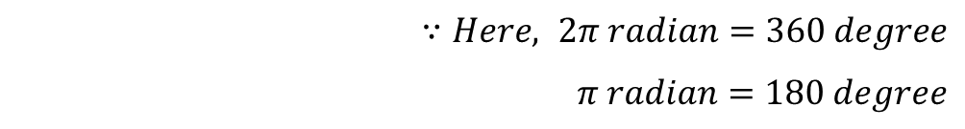
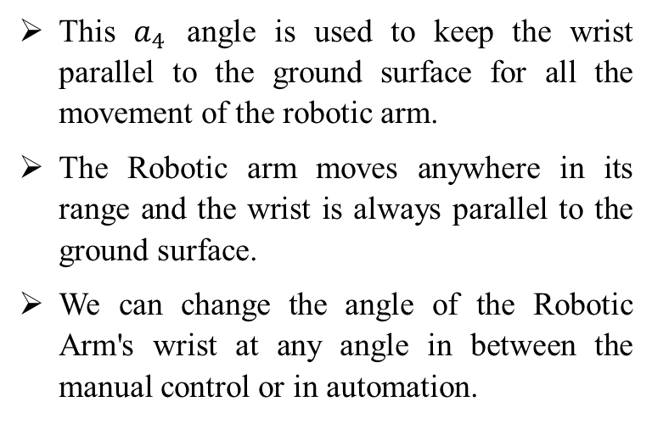
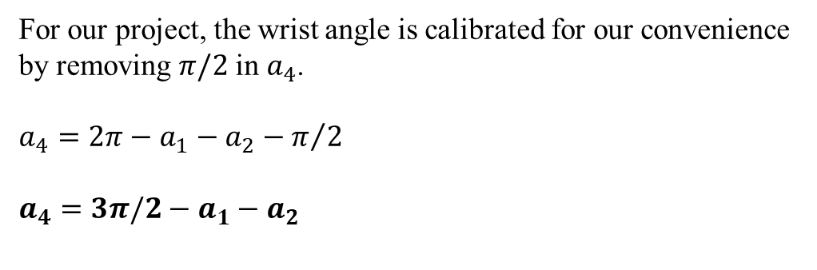
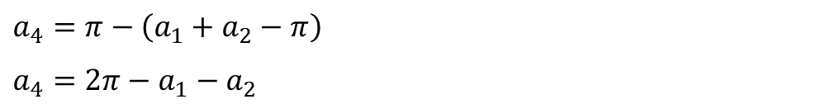
KINEMATIC (Continuation)
$∵Here, 2π radian=360 degree$
$π radian=180 degree$
This $a_{4}$ angle is used to keep the wrist parallel to the ground surface for all the movement of the robotic arm.
The Robotic arm moves anywhere in its range and the wrist is always parallel to the ground surface.
We can change the angle of the Robotic Arm's wrist at any angle in between the manual control or in automation.
$a_{4}=π−\left(a_{1}+a_{2}−π\right)$
$a_{4}=2π−a_{1}−a_{2}$
For our project, the wrist angle is calibrated for our convenience by removing $π/2$ in $a_{4}$.
$a_{4}=2π−a_{1}−a_{2}−π/2$
$a_{4}=3π/2−a_{1}−a_{2}$

Slide 16
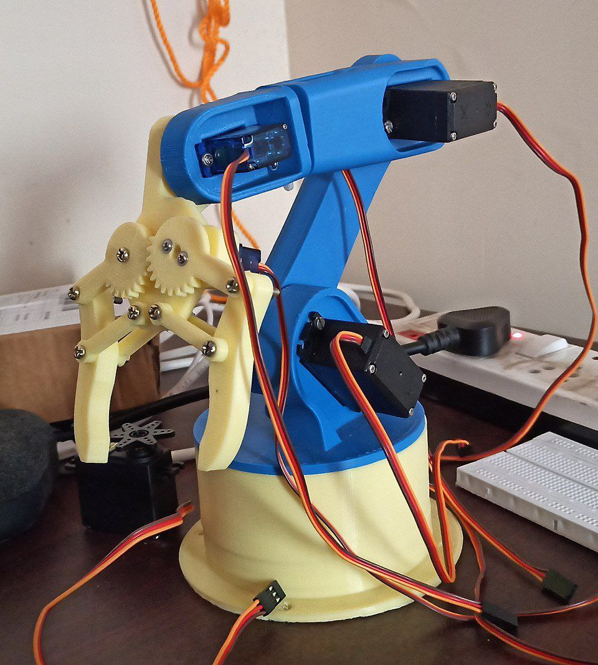
HARDWARE MODULE

Slide 17
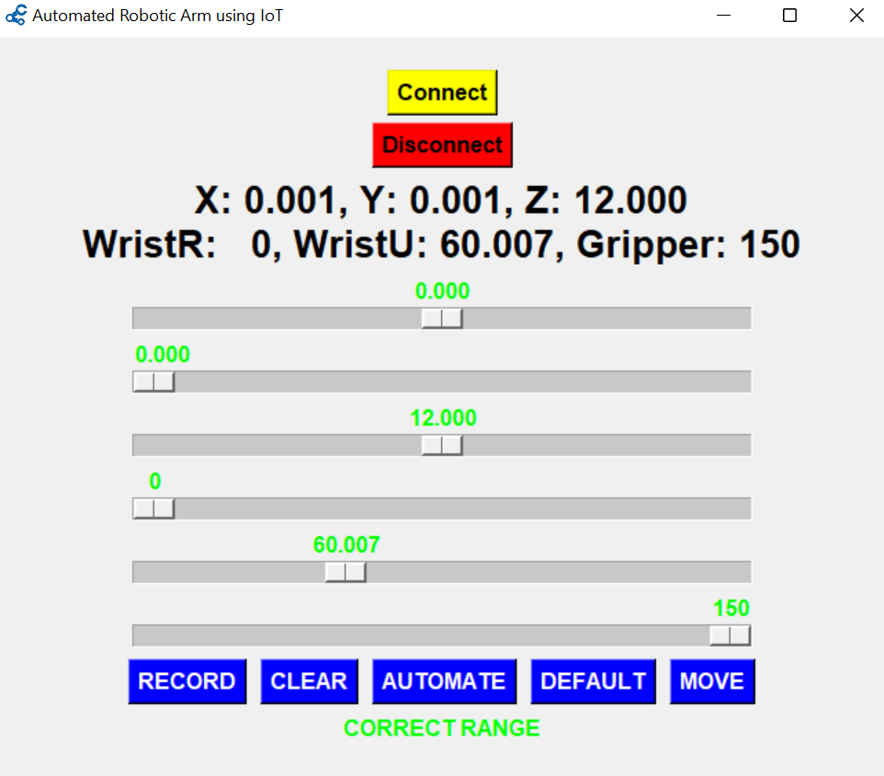
SOFTWARE

Slide 18
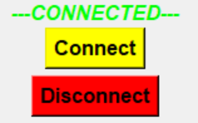
HOW TO USE SOFTWARE
First powerup the ESP32, then only WiFi Access Point is enabled.
After that connect your PC or Laptop to ESP32 Access Point WiFi and enter the password.
After WiFi is connected to the PC or Laptop. Open the Robotic Arm App.
Click Connect Button.
If connection is successful, then ‘---CONNECTED---’ is displayed in the app.

Slide 19
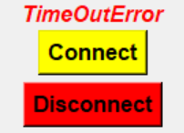
If connection is not success, then ‘TimeOutError’ is displayed in the app. (‘TimeOutError’ comes after some time delay so wait after press ‘Connect’ Button when this Button do not come back its normal position.)
If ‘TimeOutError’ comes WiFi is not connected properly. So, reconnect the ESP32 Access Point WiFi.
If nothing is happened, when clicking of the ‘Connect’ Button. Then there is no WiFi connected to your system. So, connect ESP32 WiFi to your system.

Slide 20
After successful connection, Click ‘DEFAULT’ Button. Then powerup the Robotic arm and Click ‘MOVE’ Button to move our robotic arm in default position.
After that adjust X, Y, Z, Wrist Rotate, Wrist Up Down, Gripper sliders and click ‘MOVE’ button, then robotic arm moves according to the adjustments.
Here you can record the adjustments and automate the robotic arm.
Adjust the sliders for required position and Click ‘RECORD’ button to record each position and then click ‘AUTOMATE’ button, then robotic arm moves these recorded positions automatically three times (three times is default, you can change it).
Even the Automation completed the recorded positions are saved in your system. After closing the app, the recorded positions are still saved in the system.

Slide 21
We can reuse that recorded positions again and again. We can add additional position after the previous positions by clicking ‘RECORD’ button.
If you want to clear all saved positions then you can click ‘CLEAR’ button to clear all the recorded values. Then we should record from the beginning.
The Wrist Up Down slider is automatically adjusted according to X, Y, Z.
You can also adjust Wrist Up Down slider. It gives flexibility to operate robotic arm.
You can close this app by clicking ‘Disconnect’ button also.

Slide 22
ADVANTAGES
Improved safety. Robotic arms help keep workers safe by operating in environments that are hazardous and executing tasks that present high risk of injury to humans.
Improved efficiency and productivity.
Enhanced precision.
Greater flexibility.
Easy to operate.
Low Cost.

Slide 23
REFERENCE
[1] Xi Jiang, Noah Apthorpe, "Automating Internet of Things Network Traffic Collection with Robotic Arm Interactions", Networking and Internet Architecture (cs.NI); Cryptography and Security (cs.CR); Robotics (cs.RO), 30 Sep 2021, doi:2110.00060.
[2] M. K. Ishak and N. M. Kit, "Design and Implementation of Robot Assisted Surgery Based on Internet of Things (IoT)," International Conference on Advanced Computing and Applications (ACOMP), 2017, pp. 65-70, doi: 10.1109/ACOMP.2017.20.
[3] S. Fu and P. C. Bhavsar, "Robotic Arm Control Based on Internet of Things," 2019 IEEE Long Island Systems, Applications and Technology Conference (LISAT), 2019, pp. 1-6, doi: 10.1109/LISAT.2019.8817333.
[4] Victor H.Benitez, RodrigoSymonds, David E.Elguezabal, "Design of an affordable IoT open-source robot arm for online teaching of robotics courses during the pandemic contingency" , HardwareX, Volume 8, October 2020, e00158, doi: 10.1016/j.ohx.2020.e00158.
[5] N. K. Agrawal, V. K. Singh, V. S. Parmar, V. K. Sharma, D. Singh and M. Agrawal, "Design and Development of IoT based Robotic Arm by using Arduino," Fourth International Conference on Computing Methodologies and Communication (ICCMC), 2020, pp. 776-780, doi: 10.1109/ICCMC48092.2020.ICCMC-000144.

Slide 24
[6] K. Jahnavi and P. Sivraj, "Teaching and learning robotic arm model," 2017 International Conference on Intelligent Computing, Instrumentation and Control Technologies (ICICICT), 2017, pp. 1570-1575, doi: 10.1109/ICICICT1.2017.8342804.
[7] Jegede Olawale, Awodele Oludele, Ajayi Ayodele, and Ndong Miko Alejandro Babcock University, Ilisan- Remo, Nigeria, "Development of a Microcontroller Based Robotic Arm", January 2007.
[8] Mohd Ashiq KamarilYusoff, Reza EzuanSamin, Babul Salam KaderIbrahim, "Wireless Mobile Robotic Arm", Volume 41, 2012, doi.org/10.1016/j.proeng.2012.07.285.
[9] Wan Muhamad Hanif WanKadir, Reza EzuanSamin, Babul Salam KaderIbrahim, "Internet Controlled Robotic Arm", 2012, doi.org/10.1016/j.proeng.2012.07.284.
[10] Jamshed Iqbal, Raza ul Islam, and Hamza Khan, "Modeling and Analysis of a 6 DOF Robotic Arm Manipulator", Canadian Journal on Electrical and Electronics Engineering Vol. 3, No. 6, July 2012.

Slide 25
[11] https://www.arduino.cc/reference/en/
[12] https://esp32io.com/tutorials/esp32-hello-world
[13] https://en.wikibooks.org/wiki/C%2B%2B_Language
[14] https://docs.platformio.org/en/stable/tutorials/espressif32/arduino_debugging_unit_testing.html

Slide 26


